Slide 1
CONCEPT LEARNING AND THE GENERAL-TO-SPECIFIC 0RDERING
A simple form of supervised learning

Slide 2
Concept Learning
This is the simplest form of machine learning…..supervised learning
The idea is to create general rules from specific training examples
Concept learning can be formulated as a problem of searching through a predefined space of potential hypothesis
For a hypothesis that best fits the training examples.

Slide 3

How do we Learn?

Slide 4
Concept Learning
Much of learning involves acquiring general concepts from specific training examples
People, for example, continually learn general concepts or categories such as "bird," "car,“
Each such concept can be viewed as describing some subset of objects or events defined over a larger set (e.g., the subset of animals that constitute birds
Alternatively, each concept can be thought of as a boolean-valued function defined over this larger set (e.g., a function defined over all animals, whose value is true for birds and false for other animals).

Slide 5
Concept Learning – Formally defined…
The problem of automatically inferring the general definition of some concept, given examples labeled as members or nonmembers of the concept.
This task is commonly referred to as concept learning, or approximating a boolean-valued function from examples.
Concept learning. Inferring a boolean-valued function from training examples of its input and output.
It helps in finding consistent hypothesis or concepts.

Slide 6
Definition of Concept Learning
“Inferring a Boolean-valued function from training examples of its input and output”

Slide 7
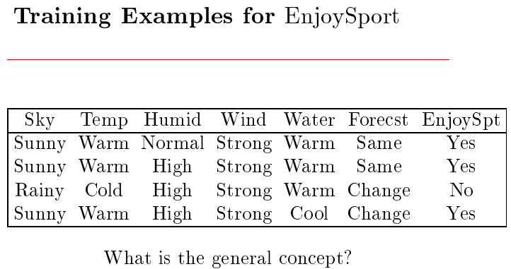
Example Dataset
Consider the example task of learning the target concept "days on which my friend Aldo enjoys his favorite water sport.
Table describes a set of example days, each represented by a set of attributes. The attribute EnjoySport indicates whether or not Aldo enjoys his favorite water sport on this day.

Slide 8
Representing Hypothesis
The task is to learn to predict the value of EnjoySport for an arbitrary day, based on the values of its other attributes.
What hypothesis representation shall we provide to the learner in this case?
Let us begin by considering a simple representation in which each hypothesis consists of a conjunction of constraints on the instance attributes.
In particular, let each hypothesis be a vector of six constraints, specifying the values of the six attributes Sky, AirTemp, Humidity, Wind, Water, and Forecast.

Slide 9
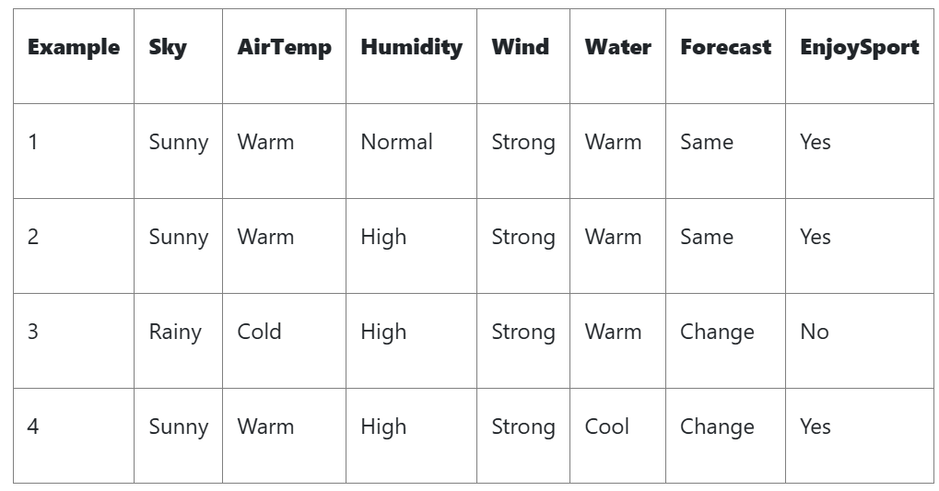
Concept Learning task
Task T: Learn to predict the value of EnjoySport for an arbitrary day, based on the values of the attributes of the day.
Performance measure P: Total percent of days (EnjoySport) correctly predicted.
Training experience E: A set of days with given labels (EnjoySport: Yes/No)

Slide 10
Representing Hypothesis
For each attribute, the hypothesis will either
indicated by a "?' that any value is acceptable for this attribute,
specify a single required value (e.g., Warm) for the attribute, or
indicated by a " ᴓ " that no value is acceptable.

Slide 11
Hypothesis Representation
A hypothesis is represented as a conjunction of constraints on attributes.
Attributes (for EnjoySport):
Sky ∈ {Sunny, Cloudy, Rainy}
AirTemp ∈ {Warm, Cold}
Humidity ∈ {Normal, High}
Wind ∈ {Strong, Weak}
Water ∈ {Warm, Cool}
Forecast ∈ {Same, Change}

Slide 12
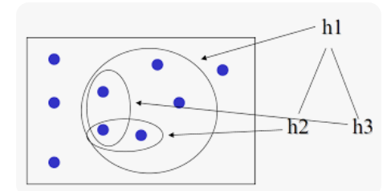
Hypothesis representation
Each hypothesis is a 6-tuple:
Specific attribute value (e.g., Sunny)
“?” (any value acceptable)
“Ø” (no value acceptable = impossible)
Concept learning can be formulated as searching through a predefined space of potential
Hypothesis for the hypothesis that best fits the training samples

Slide 13
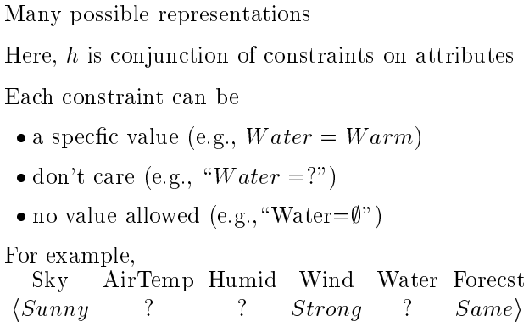
Representing Hypothesis

Slide 14


Representing Hypothesis
Most general hypothesis-
Most specific hypothesis-

Slide 15
Representing Hypothesis
If some instance x satisfies all the constraints of hypothesis h, then h classifies x as a positive example (h(x) = 1).
To illustrate, the hypothesis that Aldo enjoys his favorite sport only on cold days with high humidity (independent of the values of the other attributes) is represented by the expression
(?, Cold, High, ?, ?, ?)

Slide 16
To summarize…
The EnjoySport concept learning task requires learning the set of days for which EnjoySport = yes, describing this set by a conjunction of constraints over the instance attributes.
In general, any concept learning task can be described by the set of instances over which the target function is defined, the target function, the set of candidate hypotheses considered by the learner, and the set of available training examples.

Slide 17
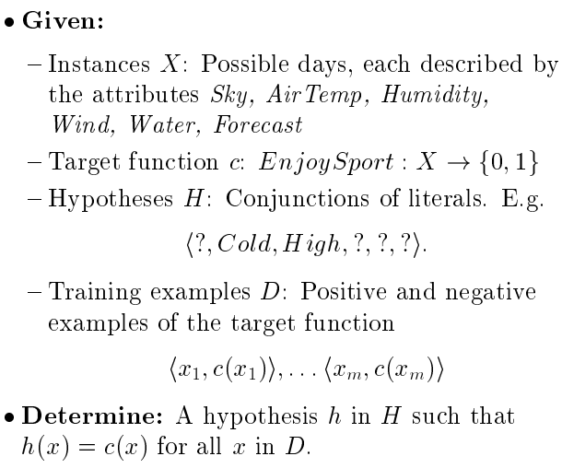
Concept Learning Task

Slide 18
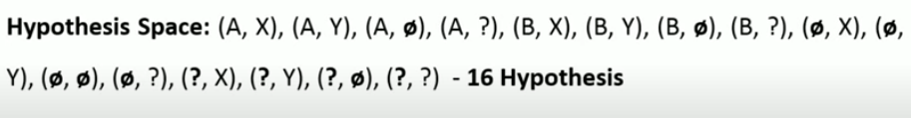
How to write all possible concepts and hypothesis
If we have 2 features each with only 2 possibilities
F1 with values X and Y (2)
F2 with values A and B (2)
Concept or instance space would have 4 (2 x 2)possibilities (X,A), (X,B), (Y, A), (Y, B)
Hypothesis space would be as following after including null and ? (4 x 4)
We will remove the ones with null combination leaving only (Ø. Ø), then semantically distinct hypothesis
would be only 10
3 x 3 + 1

Slide 19
How many potential hypothesis?
What are the possible values for each attribute?
Sky → 3 values
Airtemp→ 2
Humidity → 2
Wind → 2
Water → 2
Forecast → 2
We also have to add ? And Ø

Slide 20
So in our example the concept space would have 3*2*2*2*2*2 = 96 possibilities
Hypothesis space would have 4*3*3*3*3*3 +1 = 973
The task now is to search for a hypothesis that would represent the training examples.

Slide 22
CONCEPT LEARNING AS SEARCH
Concept learning can be viewed as the task of searching through a large space of hypotheses implicitly defined by the hypothesis representation.
The goal of this search is to find the hypothesis that best fits the training examples.
If we view learning as a search problem, then it is natural that our study of learning algorithms will examine different strategies for searching the hypothesis space.
We will be particularly interested in algorithms capable of efficiently searching very large or infinite hypothesis spaces, to find the hypotheses that best fit the training data.

Slide 23
General to specific Ordering of Hypothesis
In concept learning we have to find a hypothesis that best fits the training examples.
In most concept learning algorithms the search is through the hypothesis space.
The hypothesis is ordered from the most general to the most specific

Slide 24
General-to-Specific Ordering of Hypotheses
Many algorithms for concept learning organize the search through the hypothesis space by relying on a very useful structure that exists for any concept learning problem: a general-to-specific ordering of hypotheses.
To illustrate the general-to-specific ordering, consider the two hypotheses
h1 = (Sunny, ?, ?, Strong, ?, ?)
h2 = (Sunny, ?, ?, ?, ?, ?)
Now consider the sets of instances that are classified positive by hl and by h2.
Because h2 imposes fewer constraints on the instance, it classifies more instances as positive.
In fact, any instance classified positive by hl will also be classified positive by h2.
Therefore, we say that h2 is more general than hl.

Slide 25
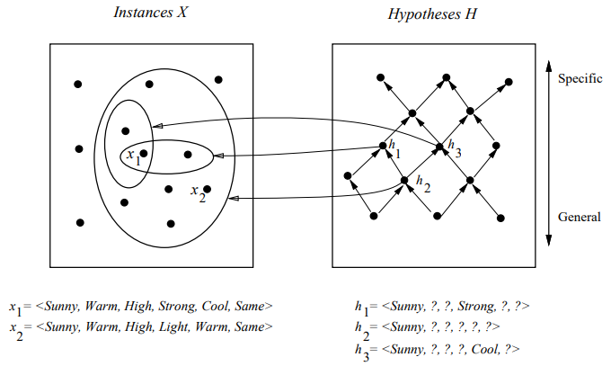
Instance, Hypothesis and More-General-Than
Consider the three hypotheses hl, h2, and h3
As noted earlier, hypothesis h2 is more general than hl because every instance that satisfies hl also satisfies h2.
Similarly, h2 is more
general than h3.

Slide 26
Find-S Algorithm
Searching for the hypothesis

Slide 27
FIND-S ALGORITHM: FINDING A MAXIMALLY SPECIFIC HYPOTHESIS
How can we use the more-general-than partial ordering to organize the search for a hypothesis consistent with the observed training examples?
One way is to begin with the most specific possible hypothesis in H, then generalize this hypothesis each time it fails to cover an observed positive training example.
(We say that a hypothesis "covers" a positive example if it correctly classifies the example as positive.)

Slide 28
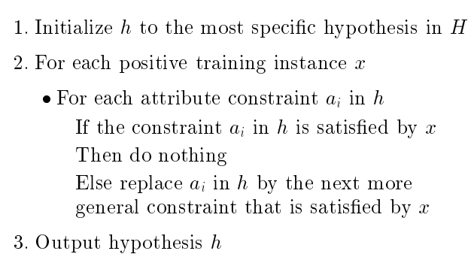
Find-S Algorithm

Slide 29
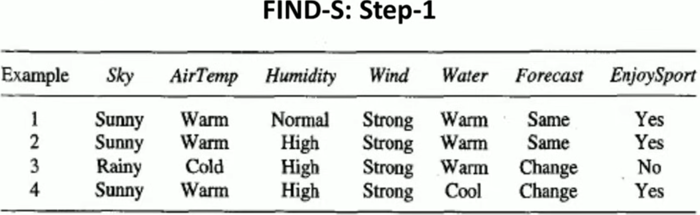
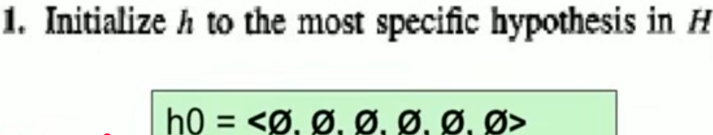

Slide 30
FIND-S ALGORITHM
The first step of FIND-S is to initialize h to the most specific hypothesis in H
Upon observing the first training example from Table, which happens to be a positive example, it becomes clear that our hypothesis is too specific.
In particular, none of the " ᴓ " constraints in h are satisfied by this example, so each is replaced by the next more general constraint that fits the example; namely, the attribute values for this training example.

Slide 31
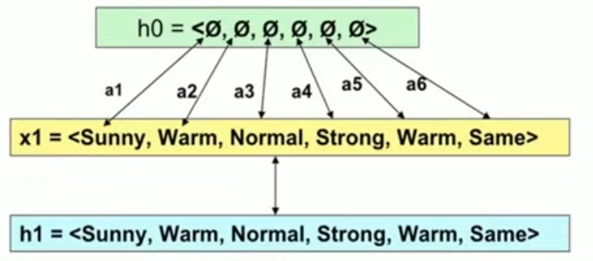

Slide 32
FIND-S ALGORITHM
This h is still very specific; it asserts that all instances are negative except for the single positive training example we have observed.
Next, the second training example (also positive in this case) forces the algorithm to further generalize h, this time substituting a "?' in place of any attribute value in h that is not satisfied by the new example.
The refined hypothesis in this case is

Slide 33
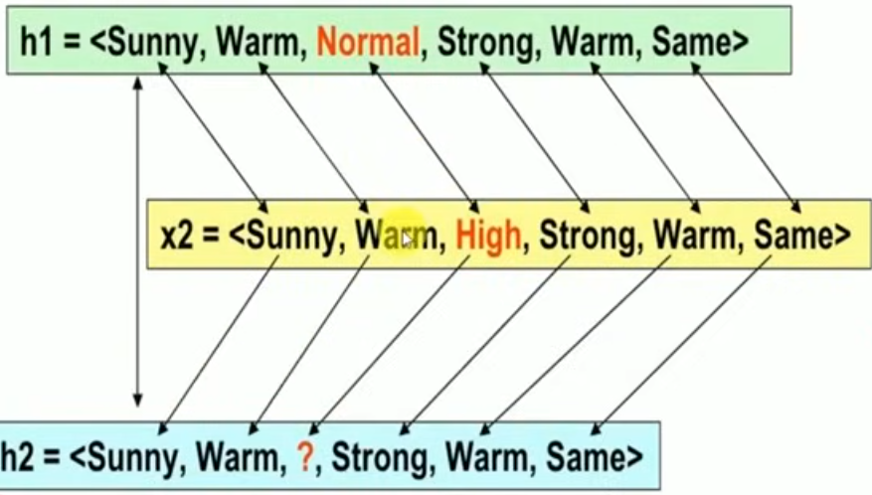

Slide 34

FIND-S ALGORITHM
Upon encountering the third training example-in this case a negative example-the algorithm makes no change to h.
In fact, the FIND-S algorithm simply ignores every negative example!
No revision to ‘h’ will be required in response to any negative example.
To complete FIND-S, the fourth (positive) example leads to a further generalization of h

Slide 35
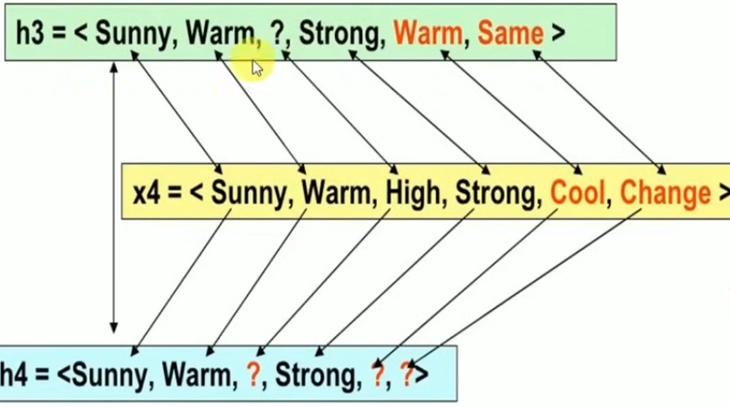

Slide 36
The FIND-S algorithm illustrates one way in which the more-general-than partial ordering can be used to organize the search for an acceptable hypothesis.
The search moves from hypothesis to hypothesis, searching from the most specific to progressively more general hypotheses along one chain of the partial ordering.
Figure (next slide) illustrates this search in terms of the instance and hypothesis spaces.
At each step, the hypothesis is generalized only as far as necessary to cover the new positive example.
Therefore, at each stage the hypothesis is the most specific hypothesis consistent with the training examples observed up to this point (hence the name FIND-S)

Slide 37
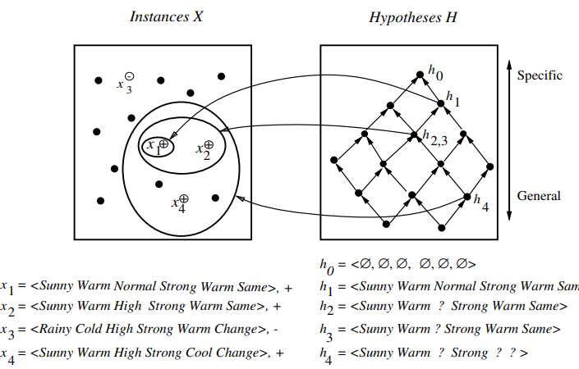
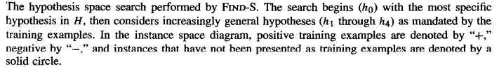

Slide 38
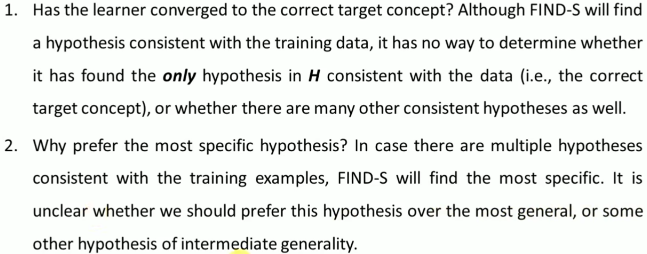
Limitations of Find-S Algorithm

Slide 39
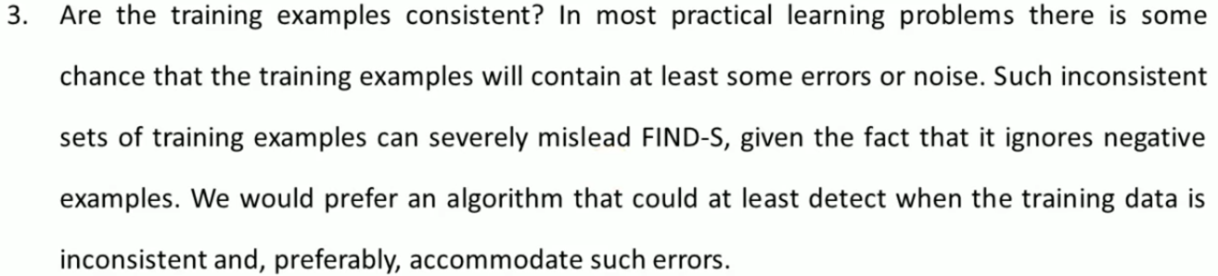
Limitations of Find-S Algorithm

Slide 40

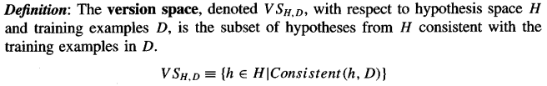
VERSION SPACES AND THE CANDIDATE-ELIMINATION ALGORITHM
FIND-S outputs a hypothesis from H, that is consistent with the training examples, this is just one of many hypotheses from H that might fit the training data equally well.
Version Space

Slide 41
The LIST-THEN-ELIMINATE Algorithm
This algorithm is used to obtain the version space.
The LIST-THEN-ELIMINATE algorithm first initializes the version space to contain all hypotheses in H, then eliminates any hypothesis found inconsistent with any training example.
The version space of candidate hypotheses thus shrinks as more examples are observed, until ideally just one hypothesis remains that is consistent with all the observed examples.
This, presumably, is the desired target concept. If insufficient data is available to narrow the version space to a single hypothesis, then the algorithm can output the entire set of hypotheses consistent with the observed data.

Slide 42
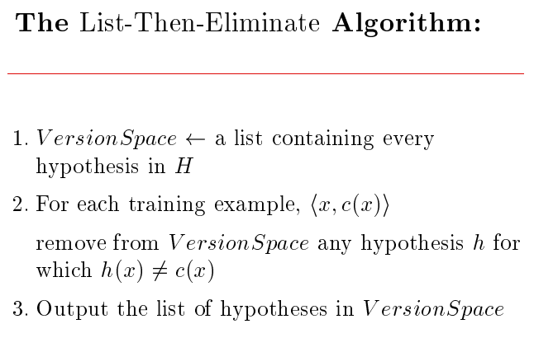
The LIST-THEN-ELIMINATE Algorithm

Slide 43
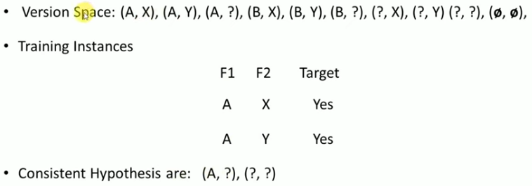

Slide 44
Candidate Elimination Algorithm

Slide 45
Candidate Elimination Algorithm
Candidate Elimination maintains the entire version space — the set of all hypotheses consistent with the training examples.
It does this by keeping track of:
S (Specific boundary): Most specific hypotheses consistent with data.
G (General boundary): Most general hypotheses consistent with data.

Slide 46


Candidate Elimination Algorithm
The CANDIDATE-ELIMINATION algorithm computes the version space containing all hypotheses from H that are consistent with an observed sequence of training examples.
It begins by initializing the version space to the set of all hypotheses in H; that is, by initializing the G boundary set to contain the most general hypothesis in H
and initializing the S boundary set to contain the most specific (least general) hypothesis

Slide 47
Step 1
S₀ = { ⟨Ø, Ø, Ø, Ø, Ø, Ø⟩ }
1. Initialize:
S ← { most specific hypothesis } = ⟨Ø, Ø, Ø, ..., Ø⟩
G ← { most general hypothesis } = ⟨?, ?, ?, ..., ?⟩
G₀ = { ⟨?, ?, ?, ?, ?, ?⟩ }
Notes:
If it’s positive (yep, this is the dish), you have to broaden your recipe guess so it still matches.
If it’s negative (nope, not the dish), you tighten the recipe so it excludes that wrong guess.

Slide 48
Candidate Elimination Algorithm
These two boundary sets delimit the entire hypothesis space, because every other hypothesis in H is both more general than S and more specific than G.
As each training example is considered, the S and G boundary sets are generalized and specialized, respectively, to eliminate from the version space any hypotheses found inconsistent with the new training example.
After all examples have been processed, the computed version space contains all the hypotheses consistent with these examples and only these hypotheses.
For positive examples, move from specific to general
For negative examples, move from general to specific

Slide 49
After seeing first example
x₁: ⟨Sunny, Warm, Normal, Strong, Warm, Same⟩ → Yes
Update S: replace Ø with the example’s values
S₁ = { ⟨Sunny, Warm, Normal, Strong, Warm, Same⟩ }
G₁ = { ⟨?, ?, ?, ?, ?, ?⟩ } (unchanged; still consistent)
S₀ = { ⟨Ø, Ø, Ø, Ø, Ø, Ø⟩ }
S₁ = { ⟨Sunny, Warm, Normal, Strong, Warm, Same⟩ }
G1 G₀ = { ⟨?, ?, ?, ?, ?, ?⟩ }
Notes:
See a positive example:
Make sure S covers it → if not, generalize S just enough so it does.
Remove from G any rules that would exclude this example.
See a negative example:
Make sure G excludes it → if not, specialize G just enough so it doesn’t.
Remove from S any rules that wrongly include this negative example.

Slide 50
After Example 2 (Positive)
x₂: ⟨Sunny, Warm, High, Strong, Warm, Same⟩ → Yes
Generalize S minimally where it conflicts with x₂ (Humidity)
S₂ = { ⟨Sunny, Warm, ?, Strong, Warm, Same⟩ }
G₂ = { ⟨?, ?, ?, ?, ?, ?⟩ }
S₀ = { ⟨Ø, Ø, Ø, Ø, Ø, Ø⟩ }
S₁ = { ⟨Sunny, Warm, Normal, Strong, Warm, Same⟩ }
S₂ = { ⟨Sunny, Warm, ?, Strong, Warm, Same⟩ }
G2 G1 G₀ = { ⟨?, ?, ?, ?, ?, ?⟩ }
Notes:
See a positive example:
Make sure S covers it → if not, generalize S just enough so it does.
Remove from G any rules that would exclude this example.
See a negative example:
Make sure G excludes it → if not, specialize G just enough so it doesn’t.
Remove from S any rules that wrongly include this negative example.

Slide 51
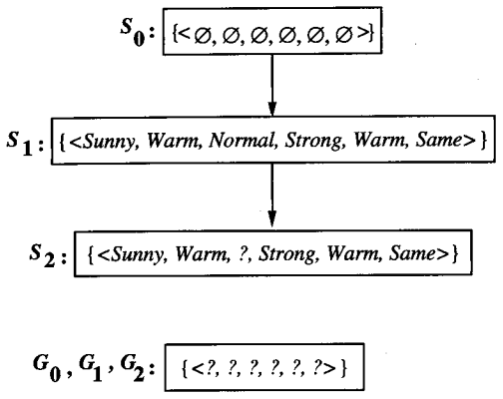
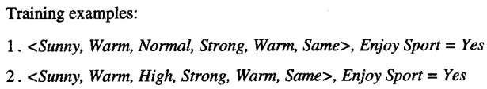
Candidate Elimination Algorithm
When the first training example is presented (a positive example in this case), the CANDIDATE-ELIMINATION algorithm checks the S boundary and finds that it is overly specific-it fails to cover the positive example.
The boundary is therefore revised by moving it to the least more general hypothesis that covers this new example.
This revised boundary is shown as S1.
When the second training example (also positive) is observed, it has a similar effect of generalizing S further to S2, leaving G again unchanged (i.e., G2 = GI = GO)

Slide 52
Candidate Elimination Algorithm
Positive training examples may force the S boundary of the version space to become increasingly general. Negative training examples play the complimentary role of forcing the G boundary to become increasingly specific
Consider the third training example. This negative example reveals that the G boundary of the version space is overly general.
The hypothesis in the G boundary must therefore be specialized until it correctly classifies this new negative example.
There are several alternative minimally more specific hypotheses. All of these become members of the new G3 boundary set.

Slide 53
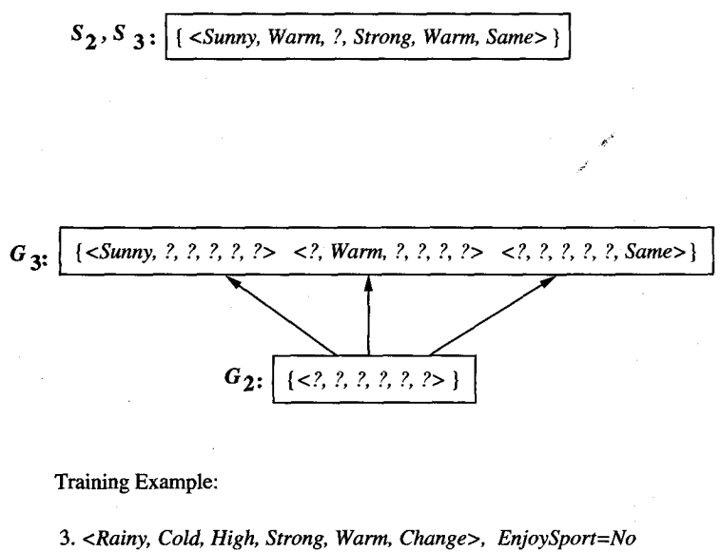
Candidate Elimination Algorithm
Given that there are six attributes that could be specified to specialize G2, why are there only three new hypotheses in G3?
The reason other hypothesis is excluded is that it is inconsistent with the previously encountered positive examples. The algorithm determines this simply by noting that h is not more general than the current specific boundary, S2.
Common feature values of S2 and S3 are generalized (?)

Slide 54
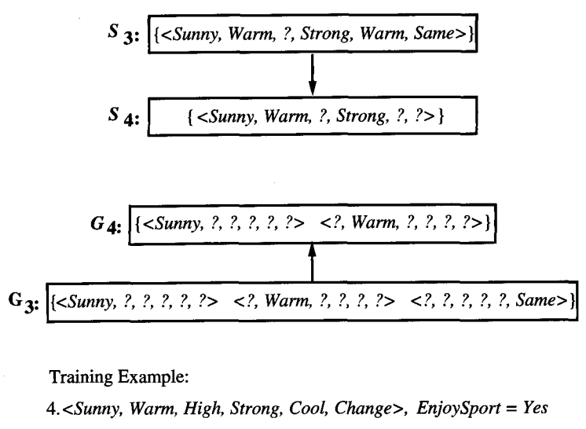
Candidate Elimination Algorithm
The fourth training example further generalizes the S boundary of the version space.
It also results in removing one member of the G boundary, because this member fails to cover the new positive example.

